Slide 1
Chapter 24
Single-Source Shortest Paths
Sun-Yuan Hsieh
謝孫源 教授
成功大學資訊工程學系

Slide 2

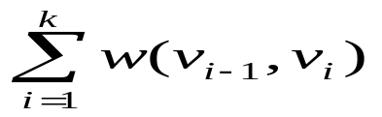



Shortest paths
How to find the shortest route between two points on a map.
  Input:
    Directed graph G = (V, E)
    Weight function w : E → R
  Weight of path p =
  =
  = sum of edge weights on path p.

Slide 3
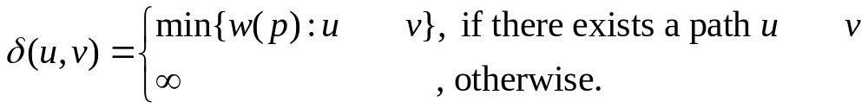
Shortest-path weight u to v :
  Shortest path u to v is any path p such that w(p) = δ(u, v).
p

Slide 4
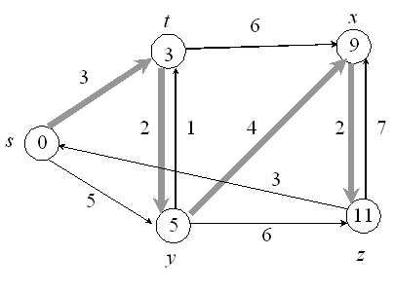
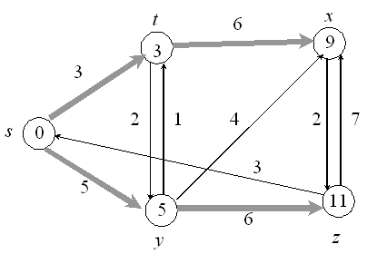
Example: shortest paths from s
[d values appear inside vertices. Shaded edges show shortest paths.]
  This example shows that the shortest path might not be unique.
  It also shows that when we look at shortest paths from one vertex to all other vertices, the shortest paths are organized as tree.

Slide 5
Can think of weights as representing any measure that
  accumulates linearly along a path.
  we want to minimize.
Example: time, cost, penalties, loss.
  Generalization of breadth-first search to weighted graphs.

Slide 6
Variants
Single-source
  Find shortest paths from a given source vertex s ∈ V to every vertex v ∈ V.
Single-destination
  Find shortest paths to a given destination vertex.
Single-pair
  Find shortest path from u to v. No way known that’s better in worst case than solving single-source.
All-pairs
  Find shortest path from u to v for all u , v ∈ V.
  We’ll see algorithms for all-pairs in the next chapter.

Slide 7
Negative-weight edges
OK, as long as no negative-weight cycles are reachable from the source.
  If we have a negative-weight cycle, we can just keep going around it, and get w(s, v) = -∞ for all v on the cycle.
  But OK if the negative-weight cycle is not reachable from the source.
  Some algorithms work only if there are no negative-weight edges in the graph.
  We’ll be clear when they’re allowed and not allowed.

Slide 8

Optimal substructure
Lemma
  Any subpath of a shortest path is a shortest path.
  Proof: Cut - and - paste.
  Suppose this path p is a shortest path from u to v.
  Then δ(u ,v) = w(p) = w(p_{ux}) + w(p_{xy}) + w(p_{yv}).

Slide 9

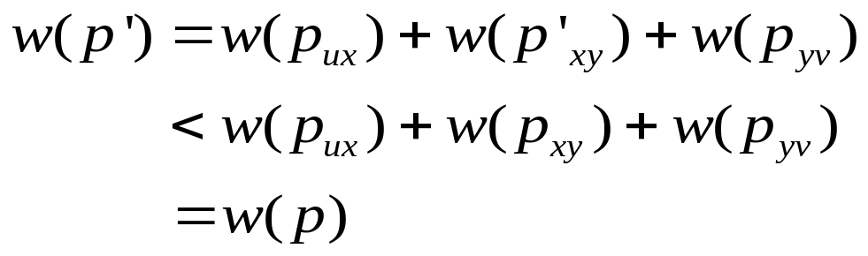
P’_{xy}
  Now suppose there exists a shorter path x y.
  Then w(p’_{xy}) < w(p_{xy})
  Construct p’ :
  Then
  So p wasn’t shortest path after all ! ■ (lemma)

Slide 10
Cycles
Shortest paths can’t contain cycles :
  Already ruled out negative-weight cycles.
  Positive-weight ⇒ we can get a shorter path by omitting the cycle.
  Zero-weight: no reason to use them ⇒ assume that our solutions won’t use them.

Slide 11

Output of single-source shortest-path algorithm
For each vertex v ∈ V :
  d [v] = δ(s, v).
    Initially, d [v] = ∞.
    Reduces as algorithms progress. But always maintain
    d [v] ≥ δ(s, v).
    Call d [v] a shortest-path estimate.
  π [v] = predecessor of v on a shortest path from s.
    If no predecessor, π[v] = NIL.
    π induces a tree ------ shortest-path tree.
    We won’t prove properties of π in lecture ------ see text.

Slide 12
Initialization
All the shortest-paths algorithms start with
INIT-SINGLE-SOURCE.
  INIT-SINGLE-SOURCE (V, s)
  For each v ∈ V
  do d [v] ← ∞
  π[v] ← NIL
  d [s] ← 0

Slide 13
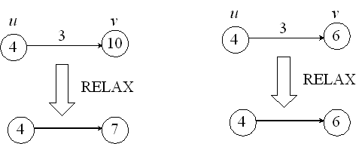
Relaxing an edge (u, v)
Can we improve the shortest-path estimate for v by going through u and taking (u, v) ?
  RELAX (u , v , w )
  If d [v] > d [u]+ w(u, v)
  then d [v] ← d [u] + w ( u, v )
  π [v] ← u

Slide 14
For all the single-source shortest-paths algorithms we’ll look at,
  start by calling INIT-SINGLE-SOURCE,
  then relax edges.
The algorithms differ in the order and how many times they relax each edge.

Slide 15
Shortest-paths properties
Based on calling INIT-SINGLE-SOURCE once and then calling RELAX zero or more times.
Triangle inequality
  For all (u, v) ∈ E, we have δ(s, v) ≤ δ(s, u) + w(u, v).
  Proof:
  Weight of shortest path s v is ≤ weight of any path s v.
  Path s u → v is a path s v, and if we use a shortest path s u, its weight isδ(s, u) + w(u, v). ■
δ(s,u)
u
w(u,v)
s
v
δ(s,v)

Slide 16
Upper-bound property
Always have d [v] ≥ δ(s, v) for all v.
Once d [v] = δ(s, v), it never changes.
  Proof: Initially true.
  Suppose there exists a vertex such that d [v] < δ(s, v).
  Without loss of generality, v is first vertex for which this happens.
  Let u be the vertex that causes d [v] to change.
  Then d [v] = d [u] + w(u, v).
  So, d [v] < δ(s, v)
  ≤ δ(s, u) + w(u, v) (triangle inequality)
  ≤ d [u] + w(u, v) (v is first violation)
  ⇒ d [v] < d [u] + w(u, v). (Contradicts d [v] = d [u] + w(u, v))
  Once d [v] reaches δ(s, v), it never goes lower. It never goes up,
  since relaxations only lower shortest-path estimates. ■

Slide 17
No-path property
If δ(s, v) = ∞, then d [v] = ∞ always.
Proof:
d [v] ≥ δ(s, v) = ∞ ⇒ d [v] = ∞. ■

Slide 18
Convergence property
If s u → v is a shortest path, d [u] =δ(s, u), and we call RELAX(u, v, w), then d [v] = δ(s, v) afterward.
Proof:
After relaxation:
d [v] ≤ d [u] + w(u, v) (RELAX code)
= δ(s, u) + w(u, v)
= δ(s, v) (lemma ----- optimal substructure)
Since d [v] ≥ δ(s, v), must have d [v] =δ(s, v). ■

Slide 19


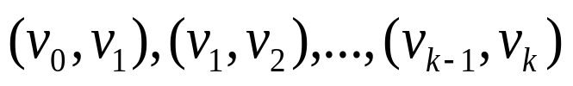






Path relaxation property
Let p = be a shortest path from . If we relax, in order, , even intermixed with other relaxations, then .
Proof:
Induction to show that after is relaxed.
Basis:
i = 0. Initially, .
Inductive step:
Assume .
Relax .
By Convergence Property, afterward and never changes.

Slide 20
d(v₁) = δ(s,v₀) + w(v₀,v₁) = δ(s,v₁)
d(v₂) = δ(s,v₁) + w(v₁,v₂) = δ(s,v₂)
d(v₃) = δ(s,v₂) + w(v₂,v₃) = δ(s,v₃)
d(v_{k}) = δ(s,v_{k-1}) + w(v_{k-1},v_{k}) = δ(s,v_{k})
v₀
v₁
v₂
v₃
v_{k-1}
v_{k}

Slide 21
The Bellman-Ford algorithm
Allows negative-weight edges.
Computes d [v] and π[v] for all v ∈ V.
Returns TRUE if no negative-weight cycles reachable from s, FALSE otherwise.

Slide 22
BELLMAN-FORD (V, E, w, s)
INIT-SINGLE-SOURCE (V, s)
for i ← 1 to |V | - 1
do for each edge (u, v) ∈ E
do RELAX (u, v, w)
for each edge (u , v) ∈ E
do if d [v] > d [u] + w(u, v)
then return FALSE
return TRUE
Core: The first for loop relaxes all edges |V | - 1 times.
Time: Θ(VE).

Slide 23
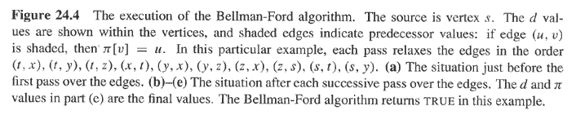
t
x
i = 1
5
6
∞
∞
6
-2
-3
s
0
8
7
-4
2
7
∞
7
∞
9
y
z

Slide 24
t
x
i = 2
5
6
∞
4
11
6
-2
-3
s
0
8
7
-4
2
7
7
∞
2
9
y
z

Slide 25
t
x
i = 3
5
6
2
4
6
-2
-3
s
0
8
7
-4
2
7
7
2
9
y
z

Slide 26
t
x
i = 4
5
2
4
6
-2
-3
s
0
8
7
-4
2
7
7
-2
2
9
y
z

Slide 27
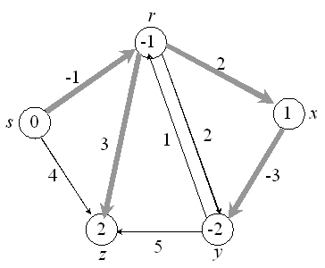
Example:
  Values you get on each pass and how quickly it converges depends on order of relaxation.
  But guaranteed to converge after |V | - 1 passes, assuming no negative-weight cycles.

Slide 28






Proof: Use path-relaxation property.
Let v be reachable from s, and let p = be a shortest path from s to v, where and .
Since p is acyclic, it has ≤ |V | - 1edges, so k ≤ |V | - 1.
Each iteration of the for loop relaxes all edges:
    First iteration relaxes .
    Second iteration relaxes .
    kth iteration relaxes .
By the path-relaxation property, .
■

Slide 29
How about the TRUE/FALSE return value?
  Suppose there is no negative-weight cycle reachable from s.
  At termination, for all (u, v) ∈ E,
  d [v] = δ(s, v)
  ≤ δ(s, u) + w(u, v) (triangle inequality)
  = d [u] + w(u, v)
  So BELLMAN-FORD returns TRUE.

Slide 30
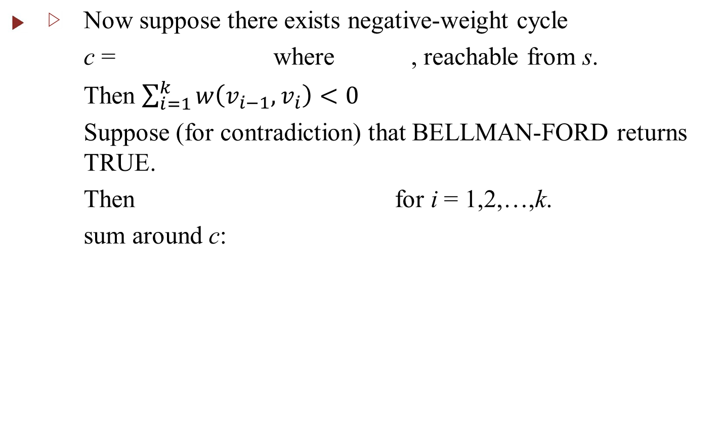


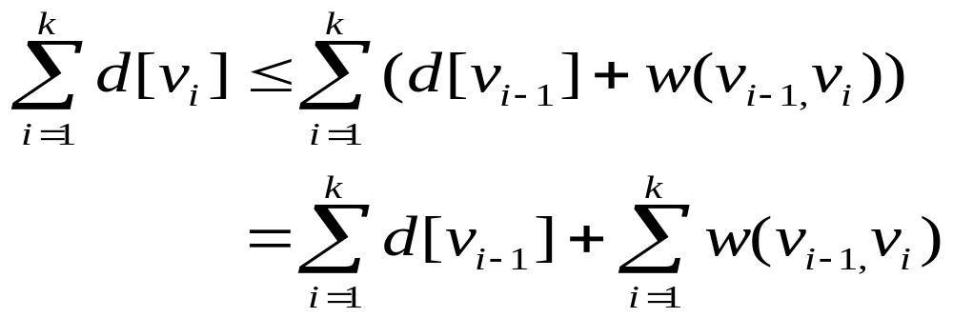

Slide 31
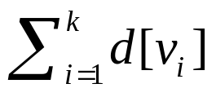
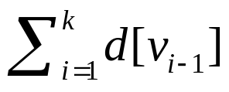
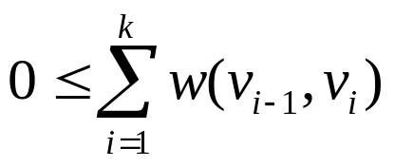
  Each vertex appears once in each summation
  and .
  ⇒ .
  This contradicts C being a negative-weight cycle! ■

Slide 32
Single-source shortest paths in a directed acyclic graph
Since a dag, we’re guaranteed no negative-weight cycles.
DAG-SHORTEST-PATHS (V, E, w, s) topologically sort the vertices
INIT-SINGLE-SOURCE (V, s)
for each vertex u, taken in topologically sorted order
do for each vertex v ∈ Adj [u]
do RELAX (u, v, w)

Slide 33
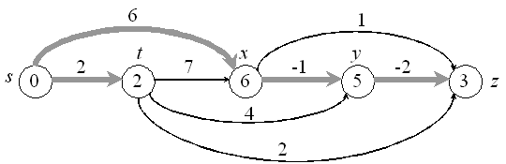
Example:
Time:Θ(V + E ).

Slide 34
6
1
r
s
t
x
y
z
5
2
7
-1
6
-2
5
∞
5
∞
0
0
∞
∞
2
2
∞
6
∞
4
3
6
3
3
4
2
Figure 24.5 The execution of the algorithm for shortest paths in a directed acyclic graph.
The vertices are topologically sorted from left to right. The source vertex is s.
The d values are shown within the vertices, and shaded edges indicate the π values.

Slide 35
Correctness: Because we process vertices in topologically sorted order, edges of any path must be relaxed in order of appearance in the path.
⇒ Edges on any shortest path are relaxed in order.
⇒ By path-relaxation property, correct. ■

Slide 36
Dijkstra’s algorithm
No negative-weight edges.
Essentially a weighted version of breadth-first search.
  Instead of a FIFO queue, uses a priority queue.
  Keys are shortest-path weights ( d [v] ).
Have two sets of vertices:
  S = vertices whose final shortest-path weights are determined.
  Q = priority queue = V – S.

Slide 37
DIJKSTRA (V, E, w, s)
INIT-SINGLE-SOURCE (V, s)
S ← Ø
Q ← V // i.e., insert all vertices into Q
While Q ≠ Ø
do u ← EXTRACT-MIN(Q)
S ← S U {u}
for each vertex v ∈ Adj [u]
do RELAX (u, v, w)
Like Prim’s algorithm, but computing d [v], and using shortest-path weights as keys.
Dijkstra’s algorithm can be viewed as greedy, since it always chooses the “lightest” (“closest”?) vertex in V – S to add to S.

Slide 38
u
u
u
u
u
u
v
v
v
v
v
v
1
1
1
1
1
∞
1
10
8
8
8
8
∞
∞
14
13
9
9
0
0
∞
5
5
7
7
13
8
8
9
y
y
y
v
v
s
s
x
x
u
u
10
10
10
10
10
10
2
2
2
2
2
2
3
3
3
3
3
3
9
9
9
9
9
9
4
4
4
4
4
4
6
6
6
6
6
6
∞
∞
10
10
10
8
8
8
13
13
∞
∞
∞
∞
∞
14
0
14
0
0
0
0
0
v
v
u
u
u
u
u
u
u
u
v
v
v
v
v
v
v
v
v
v
s
v
s
s
s
s
s
7
7
7
7
7
5
7
5
5
5
5
5
∞
∞
5
∞
∞
∞
y
∞
y
y
y
y
y
y
y
x
x
x
y
∞
y
5
5
5
5
5
∞
∞
7
7
7
7
2
2
2
2
2
2
x
x
x
x
x
x
y
y
y
y
y
y

Slide 39
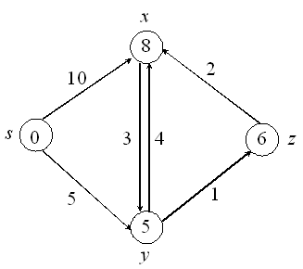
Example:
Order of adding to S: s, y, z, x.

Slide 40
Correctness:
  Loop invariant : At the start of each iteration of the while loop, d [v] = δ(s, v) for all v ∈ S.
  Initialization: Initially, S = Ø, so trivially true.
  Termination: At end, Q= Ø ⇒ S = V ⇒ d [v] = δ(s, v) for all v ∈ V.

Slide 41
Maintenance:
Need to show that d [u] = δ(s, u) when u is added to S in each iteration.
Suppose there exists u such that d [u] ≠ δ(s, u). Without loss of generality, let u be the first vertex for which d [u] ≠ δ(s, u) when u is added to S.
Observations:
  u ≠ s, since d [s] = δ(s, s) = 0.
  Therefore, s ∈ S , so S ≠ Ø.
  There must be some path s u,
  since otherwise d [u]= δ(s, u) = ∞ by no-path property.

Slide 42
So, there’s a path s u.
This means there’s a shortest path s u.
Just before u is added to S, path p connects a vertex in S ( i.e., s ) to a vertex in V - S ( i.e., u ).
Let y be first vertex along p that’s in V - S, and let x ∈ S be y’s predecessor.
p

Slide 43
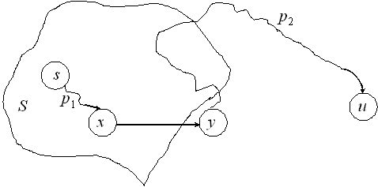


Decompose p into s x → y u.
(Could have x = s or y = u, so that or may have no edges.)
p₁
p₂

Slide 44
Claim
d [y] = δ(s, y) when u is added to S.
Proof
x ∈ S and u is the first vertex such that d [u] ≠ δ(s, u) when u is added to S ⇒ d [x] = δ(s, x) when x is added to S.
Relaxed (x , y) at that time, so by the convergence property,
d [y] = δ(s, y). ■ (claim)

Slide 45
Now can get a contradiction to d [u] ≠ δ(s, u):
y is on shortest path s u, and all edge weights are nonnegative
⇒ δ(s, y) ≤ δ(s, u)
⇒ d [y] = δ(s, y)
≤ δ(s, u)
≤ d [u] (upper-bound property).
Also, both y and u were in Q when we chose u, so d [u] ≤ d [y]
⇒ d [u] = d [y].
Therefore, d [y] = δ(s, y) = δ(s, u) = d [u].
Contradicts assumption that d [u] ≠ δ(s, u).
Hence, Dijkstra’s algorithm is correct. ■

Slide 46
Analysis: Like Prim’s algorithm, depends on implementation of priority queue.
  If binary heap, each operation takes O (lg V) time
  ⇒ O (E lg V).
  If a Fibonacci heap:
    Each EXTRACT-MIN takes O(1) amortized time.
    There are O (V) other operations, taking O (lg V) amortized time each.
    Therefore, time is O ( V lg V + E ).

Slide 47
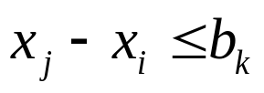
Difference constraints
Given a set of inequalities of the form .
  x’s are variables, 1≤ i, j ≤ n,
  b’s are constants, 1≤ k ≤ m.
Want to find a set of values for the x’s that satisfy all m inequalities, or determine that no such values exist.
Call such a set of values a feasible solution.

Slide 48
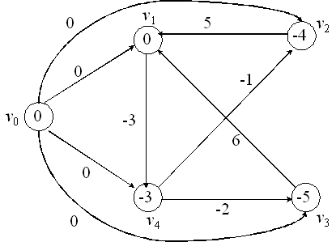
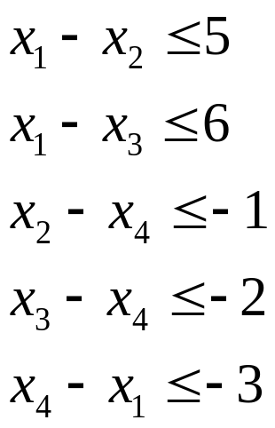
Example:
Solution: x = (0, -4, -5, -3)
Also: x = (5, 1, 0, 2) = [above solution] + 5

Slide 49
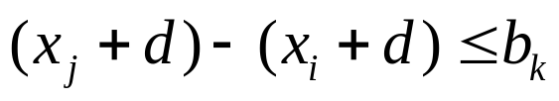
Lemma
If x is a feasible solution, then so is x + d for any constant d.
Proof
x is a feasible solution
⇒ for all i, j ,k.
⇒ . ■ (lemma)

Slide 50


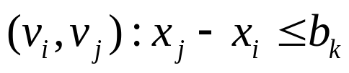

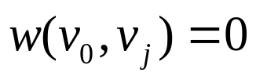
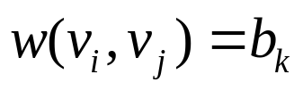
Constraint graph
G = (V , E), weighted, directed.
  V = : one vertex per variable +
  E = { is a constraint}
  U
  for all j
  if

Slide 51

Theorem
Given a system of difference constraints, let G = (V, E) be the corresponding Constraint graph.
1. If G has no negative-weight cycles, then
is a feasible solution.
2. If G has a negative-weight cycle, then there is no feasible solution.

Slide 52
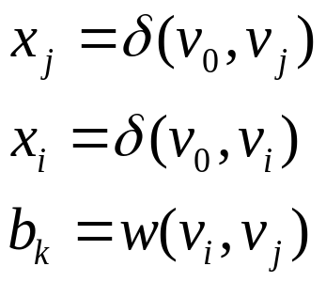
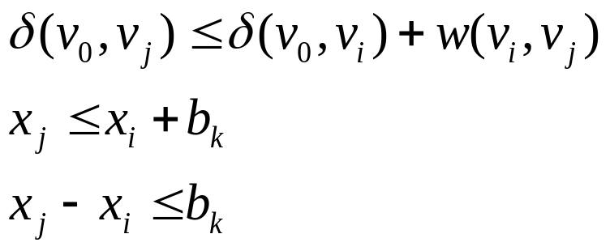
Proof
1. Show no negative-weight cycles ⇒ feasible solution.
Need to show that for all constraints. Use
By the triangle inequality,
Therefore, feasible.

Slide 53



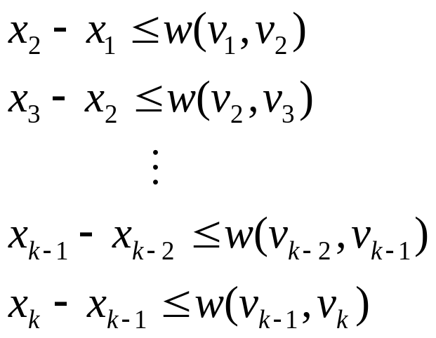
2. Show negative-weight cycles ⇒ no feasible solution.
Without loss of generality, let a negative-weight cycle be
C = where ( can’t be on C, since has
no entering edges.) C corresponds to the constraints
(The last two inequalities above are incorrect in the first three printings of the book. They were corrected in the fourth printing.)

Slide 54


If x is a solution satisfying these inequalities, it must satisfy their sum.
So add them up.
Each is added once and subtracted once.
We get 0 ≤ w (C).
But w (C) < 0 , since C is a negative-weight cycle.
Contradiction ⇒ no such feasible solution x exists.
■ (theorem)

Slide 55


How to find a feasible solution
1. Form constraint graph.
    n + 1 vertices.
    m + n edges.
    Θ (m + n) time.
2. Run BELLMAN-FORD from .
    O ((n + 1)(m + n)) = O ( + nm) time.
3. If BELLMAN-FORD returns FALSE ⇒ no feasible solution.
If BELLMAN-FORD returns TURE
⇒ set for all i.

